Slide 1

Amaradhi manikanta sai siddu
FINAL PROJECT

Slide 2
KEY LOGGER AND SECURITY
A key logger is a type of surveillance technology used to record keystrokes on a computer. Ensuring security involves detecting and preventing such malicious software to protect sensitive information and maintain user privacy.

Slide 3
AGENDA
Introduction
Problem Statement
Project Overview
End Users
Solution and Value Proposition
The "Wow" Factor in Our Solution
Modelling
Results
Conclusion and Q&A

Slide 4
PROBLEM STATEMENT
Keyloggers are tools that record keystrokes on a computer. They can be hardware or software-based, used for monitoring or malicious purposes. Keyloggers raise privacy concerns and legal issues, so it's essential to protect against them. Let me know if you need more details on any specific point!

Slide 5
PROJECT OVERVIEW
This project aims to investigate key loggers, devices or software that secretly record keystrokes to steal sensitive information. By understanding their mechanisms and potential risks, the project will develop strategies for detecting and preventing these threats, ensuring robust data security and privacy.

Slide 6
WHO ARE THE END USERS?
Keyloggers, or keystroke loggers, are tools that record what a person types on a device. While there are legitimate and legal uses for keyloggers, many uses for keyloggers are malicious. In a keylogger attack, the keylogger software records every keystroke on the victim’s device and sends it to the attacker.

Slide 7
YOUR SOLUTION AND ITS VALUE PROPOSITION
a key logger project tailored for PowerPoint preparation. With seamless integration and advanced analysis tools, it empowers users to effortlessly craft insightful presentations from their own typing activities. Enhance productivity, streamline workflow, and deliver impactful presentations with ease."

Slide 8
THE WOW IN YOUR SOLUTION
Effortless Transformation: Seamlessly convert your keystrokes into captivating presentations.
Cutting-Edge Analysis Tools: Utilize advanced algorithms to extract valuable insights from your typing activities.
Seamless Integration: Directly import analyzed data into PowerPoint for streamlined presentation creation.
Boost Productivity: Say goodbye to tedious data collection and hello to efficient workflow optimization.

Slide 9
MODELLING
Architecture Overview:
Modular Design: The keylogger code is structured into modular functions for better readability and maintenance.
Event Handling: Utilizes the pynput library to capture and handle keyboard events.
Data Logging: Implements functions to log captured data into text and JSON files.

Slide 10
MODELLING
Components:
Key Press Handling: Function: on_press(key)
Description: Captures and logs the pressed keys.
Details: Appends key press events to a list and updates the JSON log file.
Key Release Handling: Function: on_release(key)
Description: Captures and logs the released keys.
Details: Appends key release events to a list, updates the JSON log file, and accumulates keys for the text log.

Slide 11
MODELLING
Logging Functions: Text Logging: generate_text_log(key)
Description: Writes the recorded keys to key_log.txt.
JSON Logging: generate_json_file(keys_used)
Description: Dumps the list of key events to key_log.json.

Slide 12
MODELLING
Flow Diagram:
Initialization:
Set up the main GUI window.
Initialize global variables for key logging.
Event Capture:
Start capturing key events when the "Start" button is pressed.
Log key press and release events.
Data Logging:
Continuously update text and JSON log files with captured key events.
Stop Logging:
Stop capturing key events when the "Stop" button is pressed.
Update the GUI status to indicate the keylogger is stopped.

Slide 13
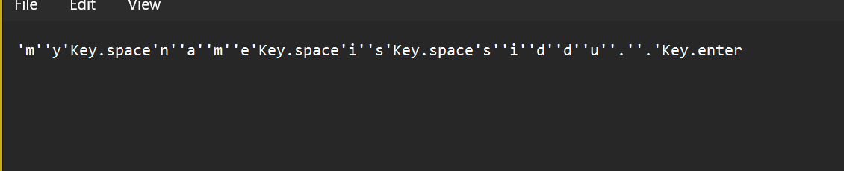
RESULTS
The best way to protect your devices from keylogging is to use a high-quality antivirus or firewall. You can also take other precautions to make an infection less likely.

